Slide 1

Project in course: "Data Science – Methods and Tools"
Course number: 67008
Yegor Kutsan & Ravino Isaev

Slide 2
our project deals with the analysis of counter strike players
Research questions:
Does Rating is predictable?
How does Rating appear to other data?

Slide 3


External Resources
All our data we get from the site:
https://www.hltv.org
On the site you can find statistic data from counter strike events.

Slide 4





Crawling

Slide 5
Crawling
While we tried to get response from requests we got an error 505.
So we import cloudscraper.

Slide 6
Crawling
At first we created a soup with BeautifulSoup of the whole website.
Then we loaded all the url’s from all the players in one list.
After we have saved all the links into a list, we start to crawl all meaningful data also with BeautifulSoup: name, age, total kills, total deaths, rating and other data about players.

Slide 7
Crawling
we have made a list for each player’s specification.
From all the lists we created one dataframe.
After we have waited about one hour to crawl all the data, we saved it in csv format.

Slide 8

Dataframe

Slide 9
Our unedited Dataframe contains 3839 players with followed 16 columns:
Name
Age
Total Kills
Headshot percentage
Total deaths
Kill/deaths Quote
Damage in Round
Grenade damage in round
Maps played
Rounds played
Kills in round
Assist in round
Deaths in round
Safed by teammate in round
Safed teammates in round
Rating

Slide 10

Final Dataframe

Slide 11
Dataframe
We loaded the raw Dataframe and started to clean him.
Drop duplicated rows
Drop all rows that had at least one ‘None’ value.
As well we changed the column ‘Headshot in percent’, because there was a ‘%’ in each row.
And now our final Dataframe contains 3492 player for 16 columns.

Slide 12
Vizualization

Slide 13
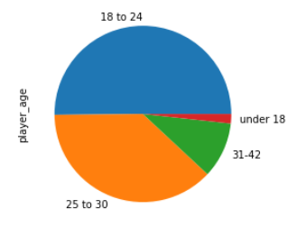
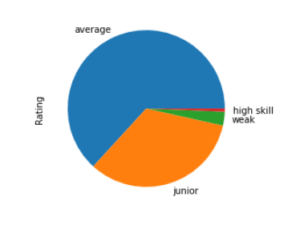
Visualization
Age
Rating

Slide 14
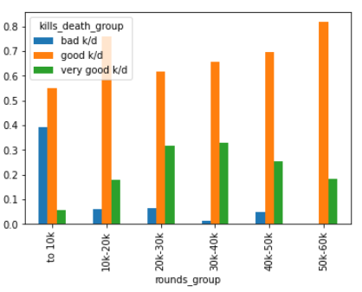
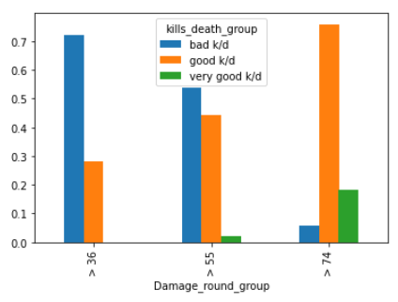
Compare with Kills/Deaths
Round played
Damage in round
Here we can see that a good k/d depends by quantity of played rounds.
Here we can see that if you made more damage in round your k/d is better.

Slide 15
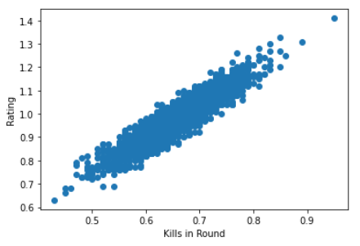
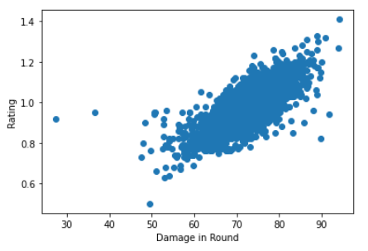
Compare with Rating
Kills in round
Damage in round
Here we can see that kills in round affects more on rating that damage in round does.

Slide 16
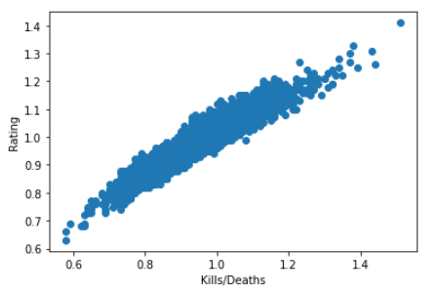
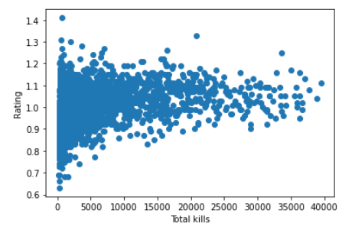
Compare with Rating
Kills/deaths
Total kills
We can see that if player wants to improve his rating he need to work on his K/D
And what is interesting that only amount of kills not so important as K/D

Slide 17

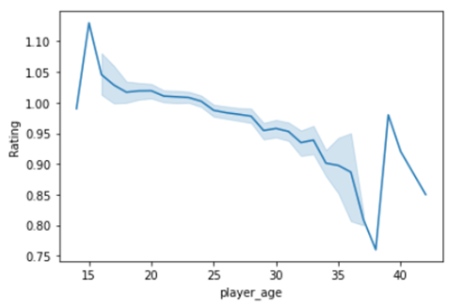
One more interesting visualization
with the age skills are decreases, but we can see that near the age 38 its goes up, it is outliers, because we don’t have enough players in that age category

Slide 18

Prediction with machine learning

Slide 19
We choose to predict the ‘Rating’ column with logistic regression.
After we split and fit the model we got an amazing r2 score of 93%.

